Slide 1
Artificial Neural Network

Slide 2
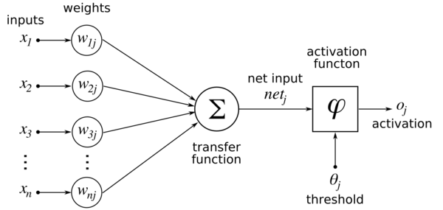
Algorithm - Backpropogation
Input – Training data matrix.
Weights are randomly initialized.
We multiply the input and weight matrix (net_{j}).
net_{j} is then passed through the activation function (sigmoid) to get final output o_{j}
As we have labelled data, y, we calculate the error ||y-o_{j}||.
Reduce the error of high confidence predictions.
Update the weights accordingly and repeat.
Source: en.wikibooks.org

Slide 3
Parameters
Input – [sentences X features]
Weight Matrix – [features X 1]
net_{j} – [sentences X 1]
y – [sentences X 1]
We need the weight matrix while testing the data, as these are the feature vectors which are trained on the data.

